Slide 1



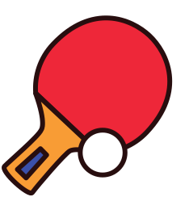
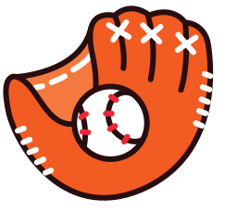


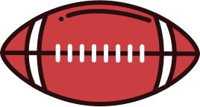
Sports
The Language of Motion

Slide 2



Play with Purpose
Athletics teach resilience and unity. Every game fosters balance, focus, and respect both on and off the field.

Slide 3

Icons of Competition
From basketball hoops to dumbbells, these symbols represent progress, energy, and the celebration of human capability.

Slide 4

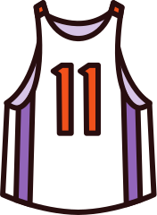
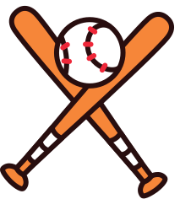
The Spirit of Teamwork
Team sports embody cooperation and shared purpose, where success is built through trust and coordination.

Slide 5
Strength and Strategy
Sports merge power and intellect, where every move matters and every victory is earned through dedication.

Slide 6

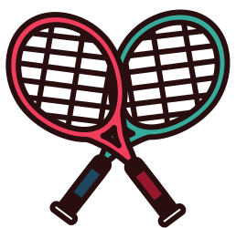


Sport as Lifestyle
An active life fosters health, joy, and purpose. Sports remind us to move, challenge limits, and live vibrantly.

Slide 7

Play Beyond Boundaries
Sports unite the world beyond culture or language—a universal expression of passion, energy, and determination.

Slide 8
The Spirit of Teamwork
Team sports embody cooperation and shared purpose, where success is built through trust and coordination.

